Slide 1

BANK CUSTOMER CHURN PREDICTION
By:- Shreya upadhyay
B.Tech 3rd year ‘c'

Slide 2
INTRODUCTION!
Welcome to our presentation on predicting customer churn! We’ll explore how data help us to predict the churning. We have use machine learning for prediction. Machine learning is a field of artificial intelligence (AI) that focuses on the development of algorithms and statistical models that enable computer systems to improve their performance on a task without being explicitly programmed. The primary goal of machine learning is to allow computers to learn from data and make predictions or decisions based on that learning. Let’s dive in!

Slide 3
UNDERSTANDING CHURN
Customer churn, also known as customer attrition or customer turnover, refers to the phenomenon where customers stop doing business with a company or cease using its products or services. Understanding churn is crucial for businesses as retaining existing customers is often more cost-effective than acquiring new ones.

Slide 4
IMPORTANCE OF THIS MODEL
The cost of attracting new customers can be five to six times more than holding on to an existing customers.
Long term customers become less costly to serve, they generate higher profits, and they may also provide new referrals.
Losing a customer usually leads to loss in profit for the bank

Slide 5

DATA COLLECTION
Gathering data is key. We’ll discuss how to collect and analyse customer behaviour to predict who might be saying adios soon.
We have taken dataset from the KAGGLE which consider of 10,000 Rows and 14 Columns of Customer data.

Slide 6

IDENTIFYING PATTERNS
By examining customer data , we can uncover patterns and trends that indicate potential churn. We have consider the “IsActiveMember” as a pattern identifying column . We can find the pattern difference between the active and unactive members with the help of this column. Let’s took for those red flags!!

Slide 7
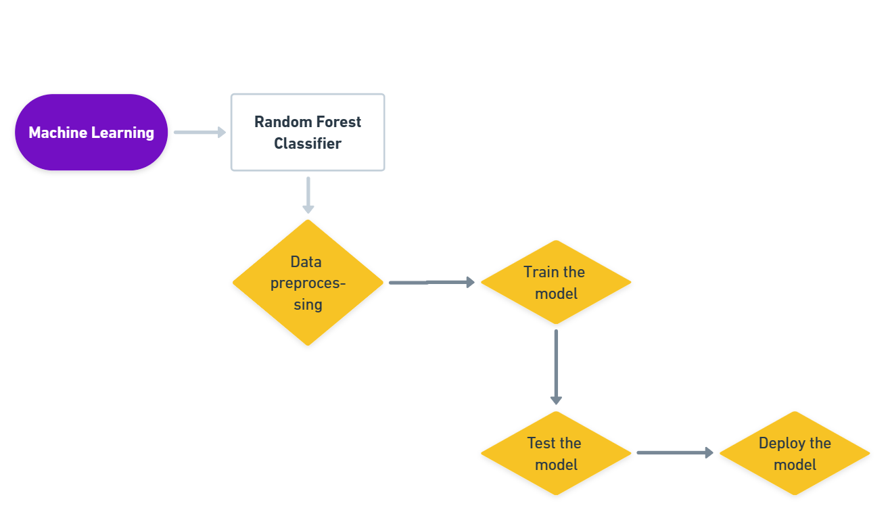

Slide 8
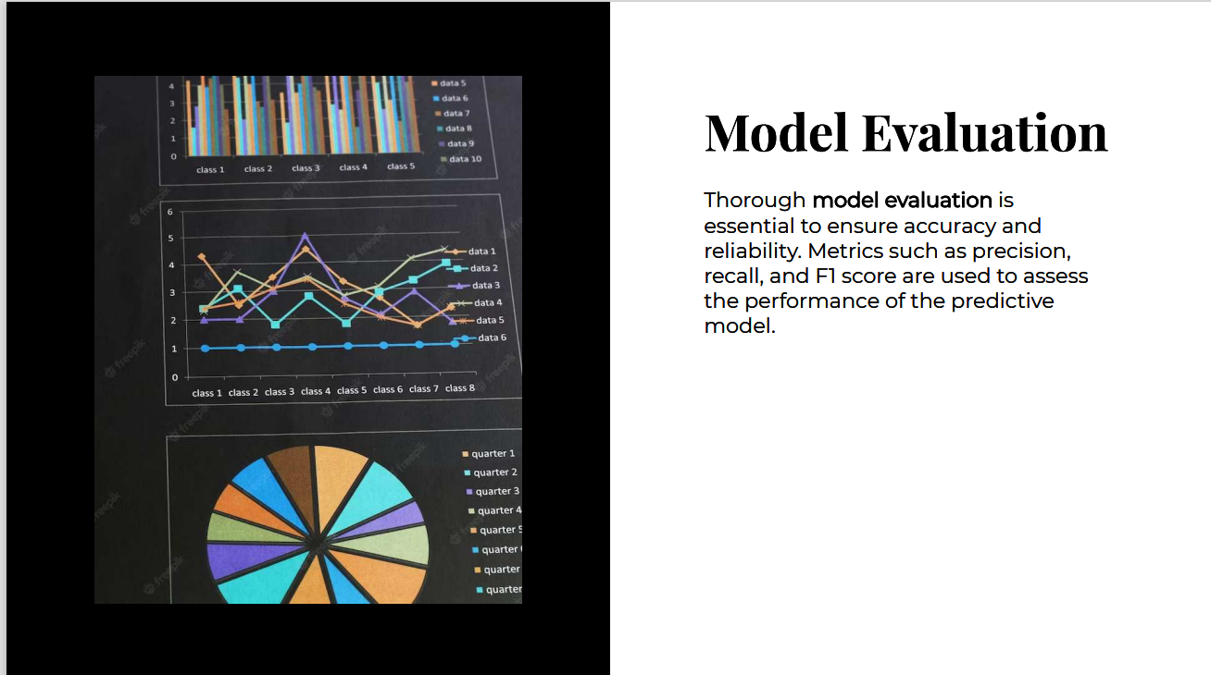

Slide 9
MODEL ACCURACY
From the review of the fitted models above, the best model that gives a decent balance of the recall and precision is the Random Forest where according to the fit on the training set, with a precision score on 1's of 0.88, out of all customers that the model thinks will churn, 88% do actually churn and with the recall score of 0.53 on the 1's, the model is able to highlight 53% of all those who churned.

Slide 10
TAKING ACTION
Once we’ve identified at-risk customers, it’s time to take action. We’ll discuss strategies to reduce churn and keep customers from saying farewell. We’ll find out the best possible way to convince the customers and find out the issues for left out.

Slide 11
CHALLENGES
While predictive modelling offers valuable insights, it also presents challenges and limitations. Addressing issues such as Imbalanced data, data quality, Dynamic behaviour, data privacy , model interpretability , and ethical considerations is crucial.

Slide 12
MODEL HYPOTHESIS
Younger people are more likely to churn.
Customers who belong to a branch that has been modernised are more likely to churn.
Customers who live in the capital are more likely to churn because the option of transferring to a different bank is somewhat limited in the countryside.

Slide 13
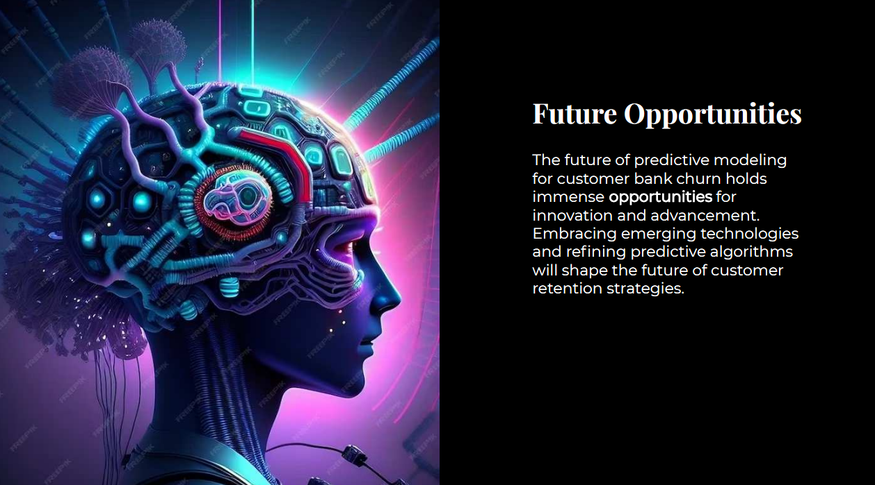

Slide 14
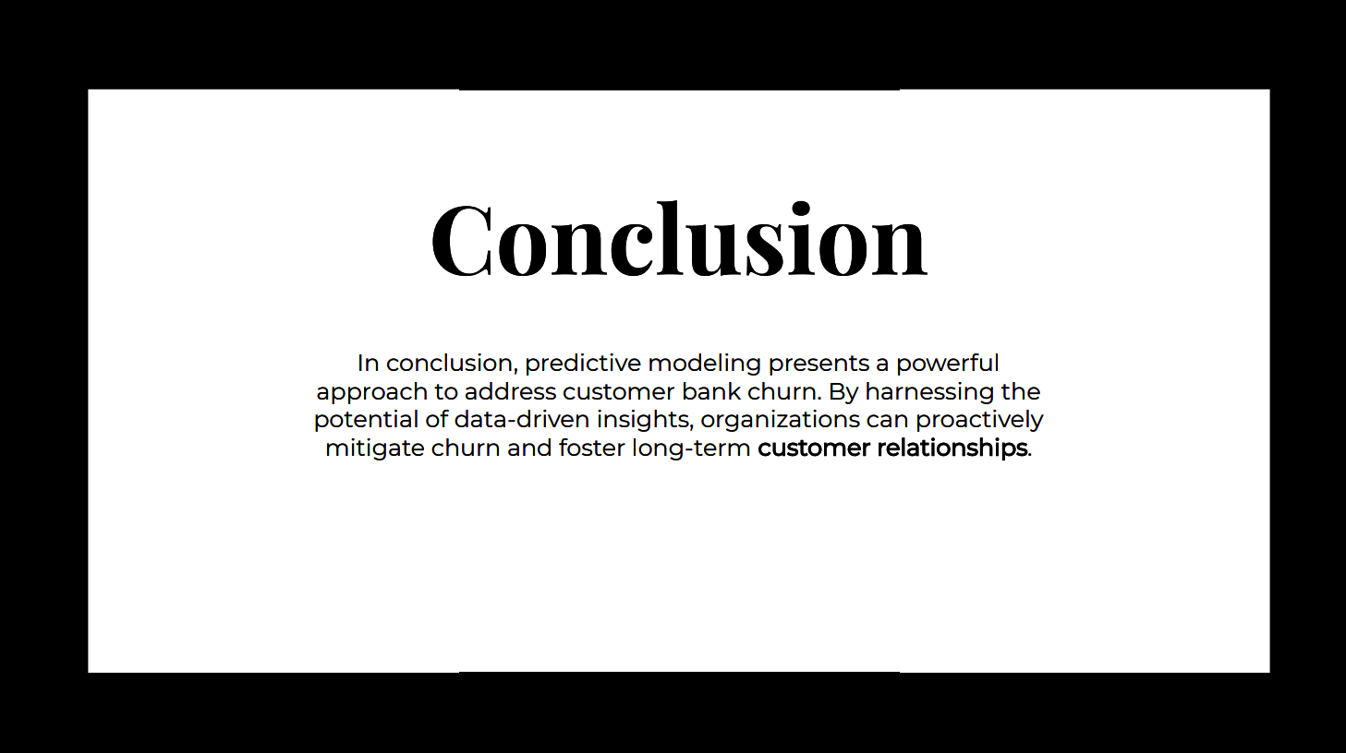

Slide 15


